Slide 1

A
Project Report
On
“CLOTH STORE MANAGEMENT SYSTEM”
SUBMITED BY:
Mr. KUNAL SHINDE(2124UCEM1109).
SUBJECT:
PROGRAMING AND PRACTICE
SOLVING USING C++
Under the Guidance of
Miss. ISHWARI TIRSE.
Department of Computer Science and Engineering
Sanjivani Rural Education Society’s
SANJIVANI UNIVERSITY
KOPARGAON – 423603, DIST : AHMEDNAGAR
2024-2025

Slide 2
INDEX
SR. NO | CONTENT | PAGE NO.
1. | INTRODUCTION | 3
2. | CODE | 4
3. | OUTPUT | 9
4. | CONCLUSION | 10

Slide 3
INTRODUCTION:
The Cloth Store Management System is a C++ program designed to assist in the coordination of a clothing retailing store. Its main function is to increase efficiency in the management of inventory, sales tracking, and customer records. Through an interactive interface, it allows store managers to add or delete stock easily, track the stock levels, and process sales transactions. Besides, it supports the functionality of producing informative sales performance and customer behavior reports. Being developed using object-oriented programming, it's a project not only simplifying the routine work of store management but also working as a good demonstration of the application of C++ to real situations for developers, giving them high experience in software development

Slide 4
CODE
#include <iostream>
#include <vector>
#include <string>
~
using namespace std;
class ClothingItem {
public:
string name;
double price;
int quantity;
ClothingItem(string n, double p, int q) : name(n), price(p), quantity(q) {}
};
class Store {
private:
vector<ClothingItem> inventory;

Slide 5
public:
void addItem(const ClothingItem& item) {
inventory.push_back(item);
cout << "Item added: " << item.name << endl;
}
void displayItems() {
cout << "Available Clothing Items:\n";
if (inventory.empty()) {
cout << "No items available.\n";
return;
}
for (const auto& item : inventory) {
cout << "Name: " << item.name
<< ", Price: $" << item.price
<< ", Quantity: " << item.quantity << endl;
}
}

Slide 6
void sellItem(const string& itemName, int quantity) {
for (auto& item : inventory) {
if (item.name == itemName) {
if (item.quantity >= quantity) {
item.quantity -= quantity;
cout << "Sold " << quantity << " of " << item.name << endl;
return;
} else {
cout << "Not enough quantity available!" << endl;
return;
}
}
}
cout << "Item not found!" << endl;
}
};
int main() {
Store myStore;
int choice;

Slide 7
do {
cout << "\n1. Add Item\n2. Display Items\n3. Sell Item\n4. Exit\n";
cout << "Enter your choice: ";
cin >> choice;
if (choice == 1) {
string name;
double price;
int quantity;
cout << "Enter item name: ";
cin >> name;
cout << "Enter item price: ";
cin >> price;
cout << "Enter item quantity: ";
cin >> quantity;
myStore.addItem(ClothingItem(name, price, quantity));

Slide 8
} else if (choice == 2) {
myStore.displayItems();
} else if (choice == 3) {
string name;
int quantity;
cout << "Enter item name to sell: ";
cin >> name;
cout << "Enter quantity to sell: ";
cin >> quantity;
myStore.sellItem(name, quantity);
}
} while (choice != 4);
cout << "Exiting the program." << endl;
return 0;
}

Slide 9
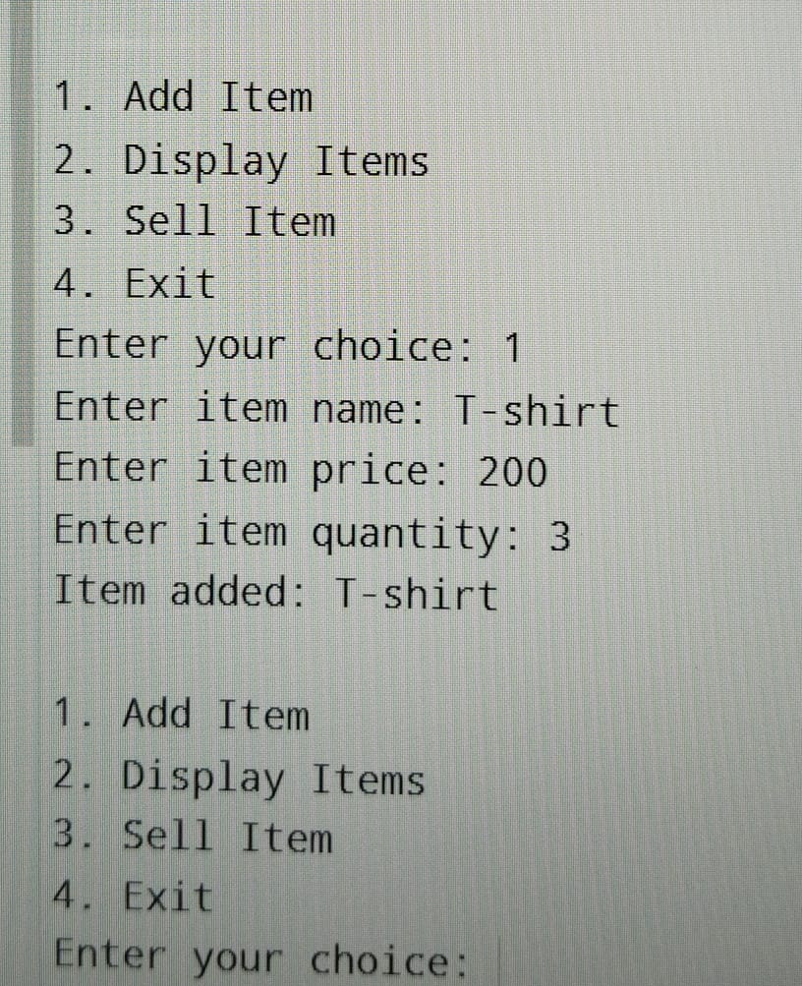
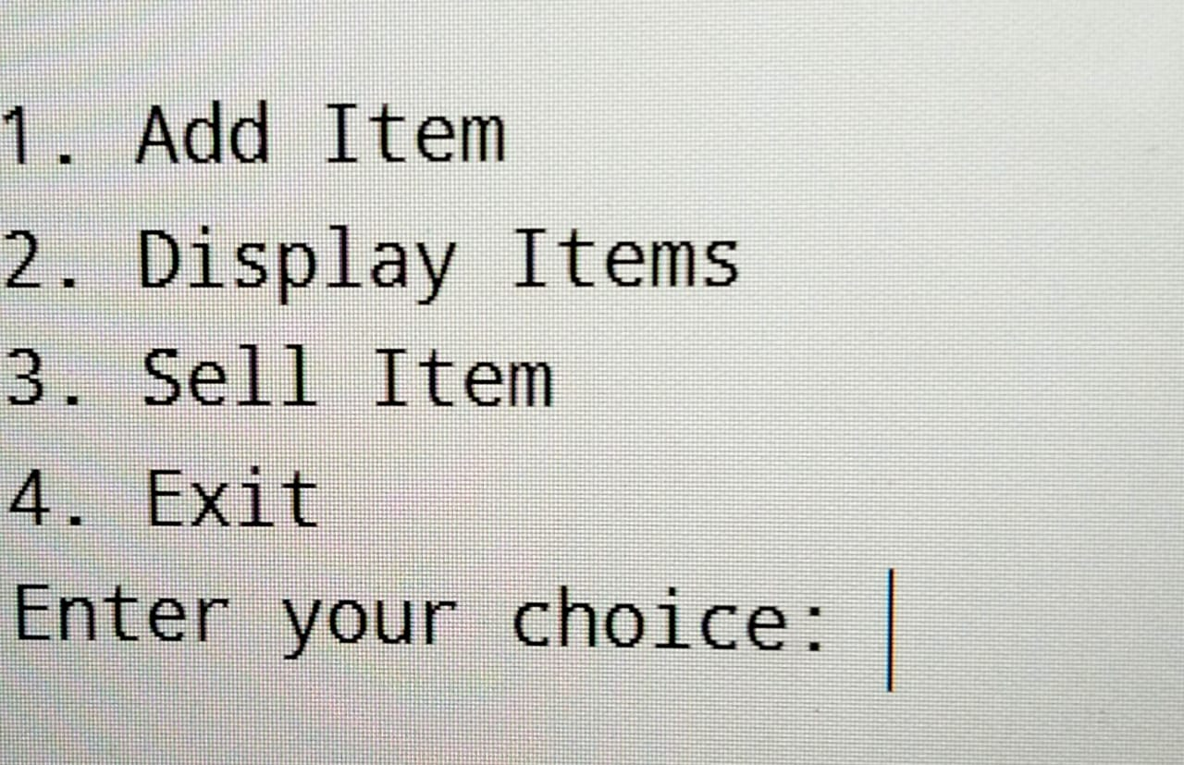
OUTPUT:

Slide 10
CONCLUSION :
The system for a cloth store is considered to be an integrated design to ensure that the workflow is smooth, customers' experiences are bettered, and inventory management is enhanced. The system works together towards giving better efficiency with real-time inventory monitoring and easy interfaces, thereby supporting informed decisions. There may be increased sales as well as satisfaction from customers when a competitive edge would be explored in a strong position among others in the market. Probably, as retail continues to evolve, the acceptance of innovative technologies will be very key for growth and survival for cloth stores.

